Slide 1
UPPER SIXTH ARTS
GEOGRAPHY
Lesson 15
Types of Migration
Notes:
Good morning, class, and welcome to our geography lesson. I am your geography teacher, Mr Kamdem. Today we are starting Lesson 15: Types of Migration.

Slide 2
CLASS INFO
Class, Chapter and Duration
Class | Upper Sixth Arts
Chapter | Module 4: Understanding and managing population dynamics across the world in general and Cameroon in particular
Duration | 2 periods (2 × 50 minutes)
Notes:
This lesson is for Upper Sixth Arts. It belongs to Module 4: Understanding and managing population dynamics across the world in general and Cameroon in particular. We shall need 2 periods to cover it.

Slide 3
IDENTIFICATION
Lesson Identification
Topic | Population Change over Space (Migration)
Sub-topic | Migration Types
Lesson | Lesson 15: Types of Migration
Notions / Concepts | Voluntary migration, forced migration, internal migration, rural exodus, counter-urbanisation, commuting, economic migrant, refugee, internally displaced person (IDP), remittance.
Syllabus focus | Voluntary and forced migration; internal migration (rural-urban, rural-rural, urban-rural, inter-urban, intra-urban, commuting, interregional); international migration (economic and political migrants); refugees and IDPs; consequences.
Competence | Learners are able to classify migrations with examples and analyse their consequences at the origin and the destination.
Notes:
Our topic is Population Change over Space (Migration), and the sub-topic is Migration Types. The key notions we shall use today are: voluntary migration, forced migration, internal migration, rural exodus, counter-urbanisation, commuting, economic migrant, refugee, internally displaced person (IDP), remittance. At the end, you should be able to do this: learners are able to classify migrations with examples and analyse their consequences at the origin and the destination.

Slide 4

HOMEWORK CORRECTION
Correction of the Homework
Question (Lesson 14: Spatial Interaction):
Define an internally displaced person.
Notes:
Before we start the new lesson, let us correct the homework I gave you at the end of Lesson 14: Spatial Interaction. The question was: Define an internally displaced person. Take out your exercise books.

Slide 5
HOMEWORK CORRECTION
Correction: Possible Answer
An internally displaced person (IDP) is someone forced to flee their home who stays inside their own country.
Notes:
Here is a good answer. An internally displaced person (IDP) is someone forced to flee their home who stays inside their own country. Compare it with your own answer and correct your work in red.

Slide 6
LESSON PLAN
Lesson Plan
Correction of the homework
Objectives and recall
Real-life situation and action to take
Learning activities
Board summary
Evaluation, remediation and homework
Notes:
Here is the plan of our lesson today. First, we shall correct the homework. Then we shall look at the objectives and recall what you already know. After that, we shall study a situation from real life and the action to take, and do the learning activities. Finally, we shall copy the board summary, do the evaluation and the remediation, and I will give you the homework.

Slide 7
OBJECTIVES
Objectives
By the end of this lesson, you should be able to:
Distinguish voluntary and forced migration.
Describe the types of internal migration with examples.
Notes:
Take your time to copy this part; we will continue together.

Slide 8
OBJECTIVES
Objectives (continued)
Describe economic and political international migration.
Distinguish refugees and IDPs.
Analyse the consequences of migration at the origin and the destination.
Notes:
By the end of this lesson, you should be able to do five things. Number 1: distinguish voluntary and forced migration. Number 2: describe the types of internal migration with examples. Number 3: describe economic and political international migration. Number 4: distinguish refugees and IDPs. Number 5: analyse the consequences of migration at the origin and the destination.

Slide 9
PREVIOUS KNOWLEDGE
Previous Knowledge
Migration is selective.
Push factors drive people out of villages.
Complementarity creates flows between places.
Notes:
Let us first remember what you already know. Migration is selective. Push factors drive people out of villages. Complementarity creates flows between places. Keep this in mind, because we shall build on it today.

Slide 10
REAL-LIFE SITUATION
Situation in Real Life
In your quarter of Garoua, a trader came from Bafoussam to expand his business; the young man who helps him came from a village near Tcholliré to earn money for his family; and a family from the Far North, who lost their home because of insecurity, rents the house opposite yours.
Notes:
Take your time to copy this part; we will continue together.

Slide 11
REAL-LIFE SITUATION
Situation in Real Life (continued)
You also hear of young Cameroonians who risk everything to reach Europe.
You ask: "All these people are migrants, but what types of migration are these, and what are their consequences?"
Notes:
Listen carefully to this situation from real life. In your quarter of Garoua, a trader came from Bafoussam to expand his business; the young man who helps him came from a village near Tcholliré to earn money for his family; and a family from the Far North, who lost their home because of insecurity, rents the house opposite yours. You also hear of young Cameroonians who risk everything to reach Europe. You ask: "All these people are migrants, but what types of migration are these, and what are their consequences?" Think about it, because I am going to ask you some questions.

Slide 12
REAL-LIFE SITUATION
Situation: Question 1
What is the problem in the situation?
Notes:
Question 1: What is the problem in the situation? Think for a moment, then raise your hand to answer.

Slide 13
REAL-LIFE SITUATION
Answer
The learner cannot classify the types of migration and their consequences.
Notes:
Good. The learner cannot classify the types of migration and their consequences.

Slide 14
REAL-LIFE SITUATION
Situation: Question 2
What is the movement of the young man from Tcholliré called?
Notes:
Question 2: What is the movement of the young man from Tcholliré called? Think for a moment, then raise your hand to answer.

Slide 15
REAL-LIFE SITUATION
Answer
Rural-urban migration (rural exodus).
Notes:
Good. Rural-urban migration (rural exodus).

Slide 16
REAL-LIFE SITUATION
Situation: Question 3
How is the Far North family different from him?
Notes:
Question 3: How is the Far North family different from him? Think for a moment, then raise your hand to answer.

Slide 17
REAL-LIFE SITUATION
Possible Answer
They were forced to flee (forced migration), while he chose to move (voluntary migration).
Notes:
Good. They were forced to flee (forced migration), while he chose to move (voluntary migration).

Slide 18
ACTION TO TAKE
Action to Take
Welcome displaced people and refugees with respect, and support development projects that give young people opportunities at home.
Notes:
From this situation, the action we are working towards in this lesson is the following: welcome displaced people and refugees with respect, and support development projects that give young people opportunities at home.

Slide 19
JUSTIFICATION
Justification of the Lesson
This lesson helps us to understand the many forms of migration in Cameroon and to face their consequences.
Notes:
Why is this lesson important for you? This lesson helps us to understand the many forms of migration in Cameroon and to face their consequences.

Slide 20
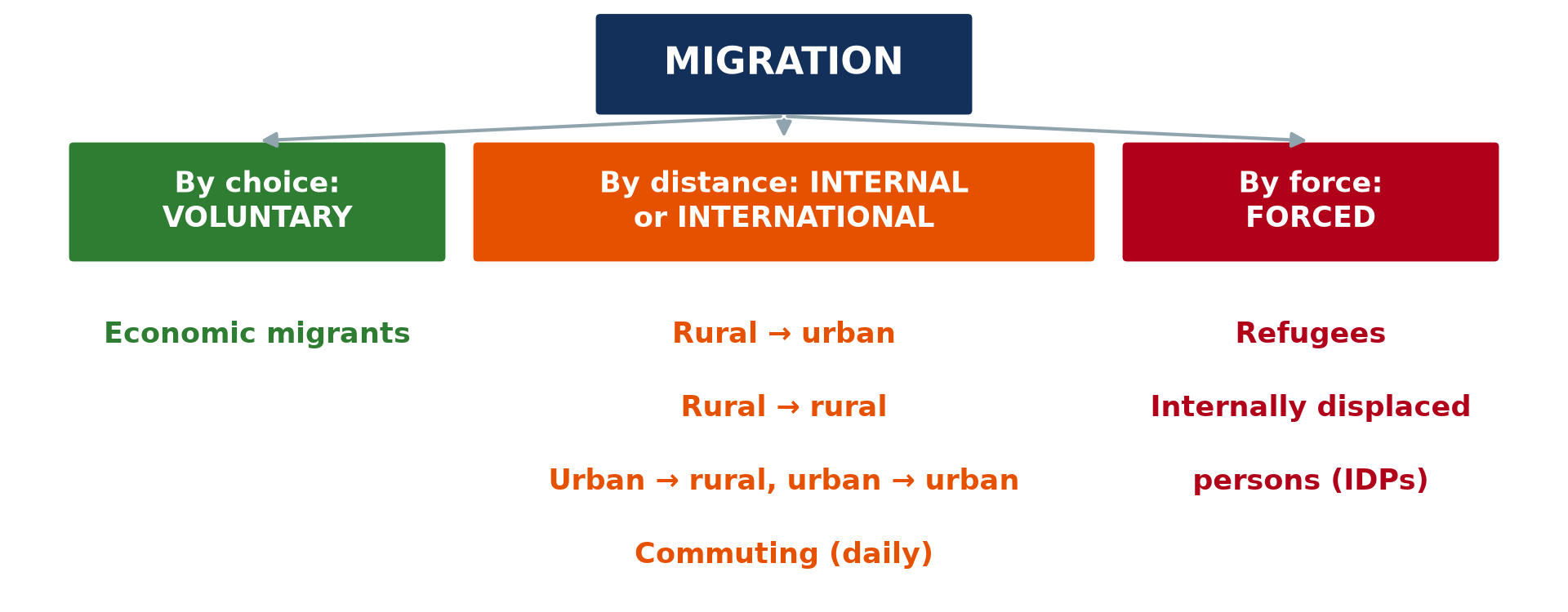
1. VOLUNTARY AND FORCED
Activity 1
Types of migration.
Notes:
Activity 1. Look carefully at this diagram: types of migration. Observe every detail before I ask the question.

Slide 21
1. VOLUNTARY AND FORCED
Activity 1: Question
Is fleeing a flood voluntary or forced migration?
Notes:
Here is the question for Activity 1: Is fleeing a flood voluntary or forced migration? Take one minute to think and write your answer in your rough notebook.

Slide 22
1. VOLUNTARY AND FORCED
Activity 1: Answer
Forced migration.
Notes:
Let us check the answer together. Forced migration.

Slide 23
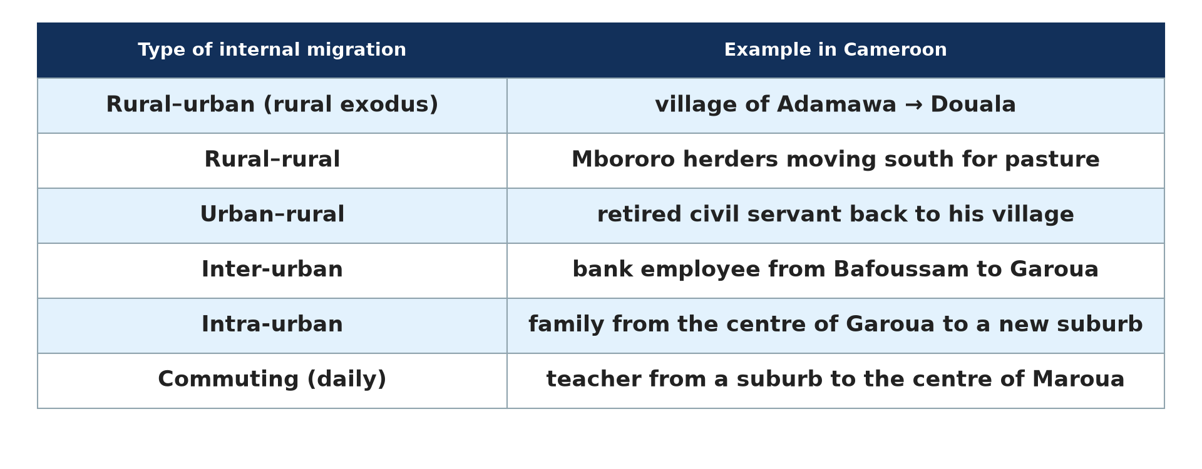
2. INTERNAL MIGRATION
Activity 2
Types of internal migration.
Notes:
Activity 2. Look carefully at this picture: types of internal migration. Observe every detail before I ask the question.

Slide 24
2. INTERNAL MIGRATION
Activity 2: Question
What type of migration is a daily trip from a suburb to the town centre for work?
Notes:
Here is the question for Activity 2: What type of migration is a daily trip from a suburb to the town centre for work? Take one minute to think and write your answer in your rough notebook.

Slide 25
2. INTERNAL MIGRATION
Activity 2: Answer
Commuting.
Notes:
Let us check the answer together. Commuting.

Slide 26

2. INTERNAL MIGRATION
Activity 3
Herders and their cattle.
Notes:
Activity 3. Look carefully at this picture: herders and their cattle. Observe every detail before I ask the question.

Slide 27
2. INTERNAL MIGRATION
Activity 3: Question
Why do herders move south in the dry season?
Notes:
Here is the question for Activity 3: Why do herders move south in the dry season? Take one minute to think and write your answer in your rough notebook.

Slide 28
2. INTERNAL MIGRATION
Activity 3: Answer
To find pasture and water: rural-rural migration.
Notes:
Let us check the answer together. To find pasture and water: rural-rural migration.

Slide 29
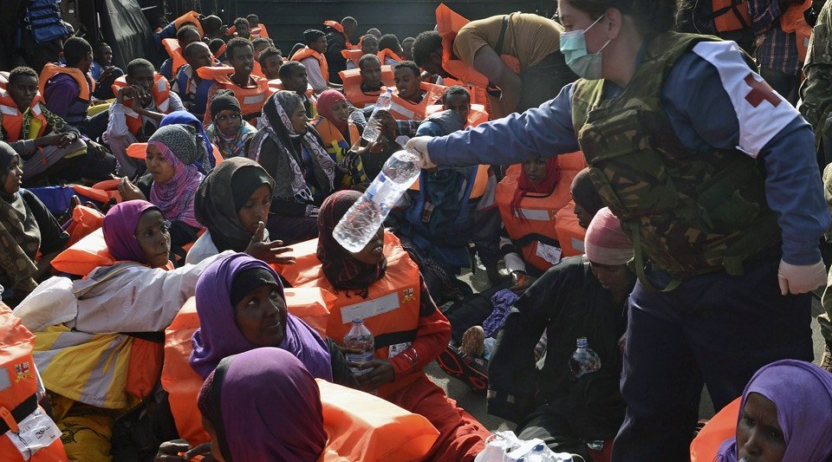
3. INTERNATIONAL MIGRATION
Activity 4
Migrants at sea.
Notes:
Activity 4. Look carefully at this picture: migrants at sea. Observe every detail before I ask the question.

Slide 30
3. INTERNATIONAL MIGRATION
Activity 4: Question
Give one advantage of emigration for the country of origin.
Notes:
Here is the question for Activity 4: Give one advantage of emigration for the country of origin. Take one minute to think and write your answer in your rough notebook.

Slide 31
3. INTERNATIONAL MIGRATION
Activity 4: Answer
Remittances sent home.
Notes:
Let us check the answer together. Remittances sent home.

Slide 32
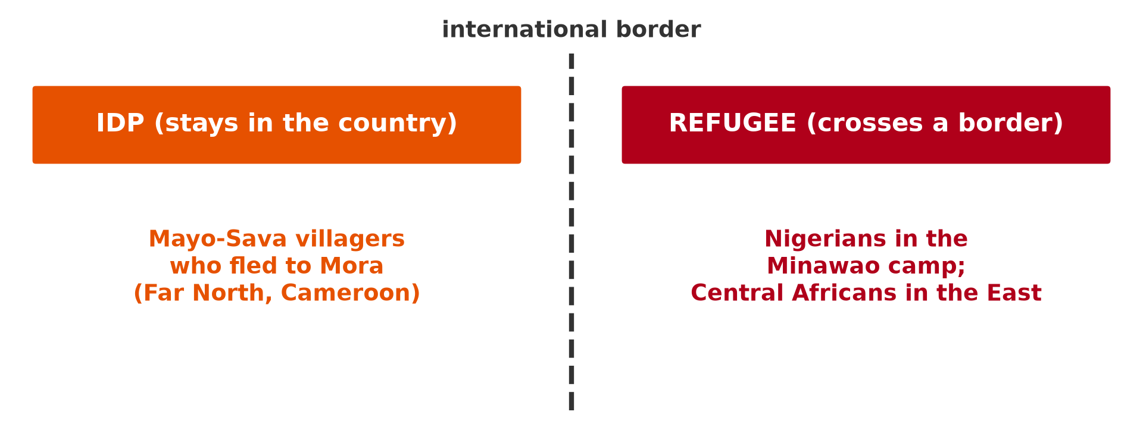
4. REFUGEES AND IDPs
Activity 5
IDP or refugee?
Notes:
Activity 5. Look carefully at this picture: iDP or refugee?. Observe every detail before I ask the question.

Slide 33
4. REFUGEES AND IDPs
Activity 5: Question
What is the difference between an IDP and a refugee?
Notes:
Here is the question for Activity 5: What is the difference between an IDP and a refugee? Take one minute to think and write your answer in your rough notebook.

Slide 34
4. REFUGEES AND IDPs
Activity 5: Answer
An IDP stays in his country; a refugee crosses an international border.
Notes:
Let us check the answer together. An IDP stays in his country; a refugee crosses an international border.

Slide 35
BOARD SUMMARY
Board Summary
Topic: Population Change over Space (Migration)
Sub-topic: Migration Types
Lesson 15: Types of Migration
Notes:
Now we are going to copy the board summary. Write the title and the headings neatly in your notebooks. I will give you enough time for each slide, so do not rush.

Slide 36
BOARD SUMMARY
DEFINITIONS
The key terms of this lesson are defined as follows:
Voluntary migration: It is a movement freely chosen by the migrant, usually for economic or social reasons.
Notes:
Let us copy the definitions. The key terms of this lesson are defined as follows. On this slide we have Voluntary migration. Write each point on a new line, with the key term first, and explain it in your own words when we revise. When you finish, we go to the next slide.

Slide 37
BOARD SUMMARY
DEFINITIONS (continued)
Forced migration: It is a movement imposed by violence, conflict, disasters or persecution.
Refugee: It is a person forced to flee who crosses an international border and is protected by international law.
Notes:
We continue with the definitions. On this slide we have Forced migration and Refugee. Write each point on a new line, with the key term first, and explain it in your own words when we revise. When you finish, we go to the next slide.

Slide 38
BOARD SUMMARY
DEFINITIONS (continued)
Internally displaced person (IDP): It is a person forced to flee who remains inside his or her own country.
Remittances: They are money sent home by migrants.
Notes:
We continue with the definitions. On this slide we have Internally displaced person (IDP) and Remittances. Write each point on a new line, with the key term first, and explain it in your own words when we revise.

Slide 39
BOARD SUMMARY
1. Voluntary versus Forced Migration
Migration is either voluntary or forced as follows:
Voluntary migration: The migrant chooses freely to leave, usually for a job, studies or family reasons. For example, a Cameroonian computer scientist who accepts a well-paid job in Germany migrates by choice.
Illustration: the types of migration
Notes:
Let us copy Voluntary versus Forced Migration. Migration is either voluntary or forced as follows. Copy the point on Voluntary migration on the left, then draw the diagram on the right: the types of migration. Give it a title and label it clearly.

Slide 40

BOARD SUMMARY
1. Voluntary versus Forced Migration
Forced migration: The migrant has no real choice because his life or property is threatened. For example, a family that flees its village because of fighting or a flood is forced to move.
Illustration: refugees
Notes:
Copy the point on Forced migration on the left, then draw the diagram on the right: refugees. Give it a title and label it clearly.

Slide 41
BOARD SUMMARY
2. Internal Migrations
A) Rural-Urban Migration
Rural-urban migration is presented as follows:
Meaning and examples: It is the mass movement of people from villages to towns, also called rural exodus. Examples are the movements from the Adamawa to Douala and from northern Nigeria to Lagos.
Illustration: types of internal migration
Notes:
Let us copy Rural-Urban Migration. Rural-urban migration is presented as follows. Copy the point on Meaning and examples on the left, then draw the diagram on the right: types of internal migration. Give it a title and label it clearly.

Slide 42
BOARD SUMMARY
2. Internal Migrations
A) Rural-Urban Migration
Push and pull factors: Villages lack jobs, electricity, schools and hospitals, and harvests are poor. Towns attract with jobs, higher wages, services and the attraction of city life.
Notes:
We continue with Rural-Urban Migration. Copy the point on Push and pull factors: write the key term first, then its explanation.

Slide 43
BOARD SUMMARY
2. Internal Migrations
A) Rural-Urban Migration
Consequences at the source: Villages lose their young workers, and food production falls. However, they receive remittances that build houses and pay school fees.
Notes:
We continue with Rural-Urban Migration. Copy the point on Consequences at the source: write the key term first, then its explanation.

Slide 44
BOARD SUMMARY
2. Internal Migrations
A) Rural-Urban Migration
Consequences at the destination: Towns receive cheap labour for industries and services. However, they suffer from slums, unemployment and crime.
Notes:
We continue with Rural-Urban Migration. Copy the point on Consequences at the destination: write the key term first, then its explanation.

Slide 45
BOARD SUMMARY
2. Internal Migrations
B) Rural-Rural Migration
Rural-rural migration is presented as follows:
Meaning and examples: It is the movement from one rural area to another. Herders move from the dry plains near Kousseri to pastures further south, and farmers move to fertile land such as the Benue valley.
Illustration: herders
Notes:
Let us copy Rural-Rural Migration. Rural-rural migration is presented as follows. Copy the point on Meaning and examples on the left, then draw the diagram on the right: herders. Give it a title and label it clearly.

Slide 46
BOARD SUMMARY
2. Internal Migrations
B) Rural-Rural Migration
Push and pull factors: Drought, overgrazing and land shortage push people out. Fertile land, pastures and water attract them.
Notes:
We continue with Rural-Rural Migration. Copy the point on Push and pull factors: write the key term first, then its explanation.

Slide 47
BOARD SUMMARY
2. Internal Migrations
B) Rural-Rural Migration
Consequences: Food production increases in the new areas, and the source area is relieved. However, conflicts between farmers and herders and deforestation may follow.
Notes:
We continue with Rural-Rural Migration. Copy the point on Consequences: write the key term first, then its explanation.

Slide 48
BOARD SUMMARY
2. Internal Migrations
C) Urban-Rural and Inter-Urban Migration
Urban-rural and inter-urban migration are presented as follows:
Urban-rural migration (counter-urbanisation): People leave the town for the countryside, for example a retired civil servant who leaves Yaoundé for his village. He brings money and new ideas, but may raise land prices.
Notes:
Let us copy Urban-Rural and Inter-Urban Migration. Urban-rural and inter-urban migration are presented as follows. Copy the point on Urban-rural migration (counter-urbanisation): write the key term first, then its explanation.

Slide 49
BOARD SUMMARY
2. Internal Migrations
C) Urban-Rural and Inter-Urban Migration
Inter-urban migration: People move from one town to another, often for work or promotion. For example, a bank employee is transferred from Bafoussam to Garoua.
Notes:
We continue with Urban-Rural and Inter-Urban Migration. Copy the point on Inter-urban migration: write the key term first, then its explanation.

Slide 50
BOARD SUMMARY
2. Internal Migrations
D) Intra-Urban Migration and Commuting
Movements inside towns are presented as follows:
Intra-urban migration: People move from one quarter to another in the same town. For example, a family moves from a rented flat in central Garoua to its own house in a new suburb, which makes the town spread outwards.
Notes:
Let us copy Intra-Urban Migration and Commuting. Movements inside towns are presented as follows. Copy the point on Intra-urban migration: write the key term first, then its explanation.

Slide 51
BOARD SUMMARY
2. Internal Migrations
D) Intra-Urban Migration and Commuting
Commuting: People travel every day between home and work without changing residence, like a teacher who lives in a suburb of Maroua. Commuting causes traffic jams in the morning and evening.
Notes:
We continue with Intra-Urban Migration and Commuting. Copy the point on Commuting: write the key term first, then its explanation.

Slide 52
BOARD SUMMARY
3. External (International) Migration
A) Economic Migrants
Economic migration is presented as follows:
Meaning and examples: Economic migrants cross borders for work and better living conditions. Examples are Filipino nurses in the United Kingdom and Malian and Senegalese workers in France.
Illustration: migrants at sea
Notes:
Let us copy Economic Migrants. Economic migration is presented as follows. Copy the point on Meaning and examples on the left, then draw the diagram on the right: migrants at sea. Give it a title and label it clearly.

Slide 53
BOARD SUMMARY
3. External (International) Migration
A) Economic Migrants
Push and pull factors: Unemployment, low wages and poverty push people out of their countries. High wages, jobs and better services attract them to rich countries.
Notes:
We continue with Economic Migrants. Copy the point on Push and pull factors: write the key term first, then its explanation.

Slide 54
BOARD SUMMARY
3. External (International) Migration
A) Economic Migrants
Consequences at the source: The country of origin loses skilled workers, which is called brain drain. However, it receives remittances that support families and investment.
Notes:
We continue with Economic Migrants. Copy the point on Consequences at the source: write the key term first, then its explanation.

Slide 55
BOARD SUMMARY
3. External (International) Migration
A) Economic Migrants
Consequences at the destination: The host country fills labour shortages and gains young workers. However, it may face pressure on services and social tensions.
Notes:
We continue with Economic Migrants. Copy the point on Consequences at the destination: write the key term first, then its explanation.

Slide 56
BOARD SUMMARY
3. External (International) Migration
B) Political Migrants
Political migration is presented as follows:
Meaning and examples: Political migrants flee war and persecution across borders. Examples are Syrians in Turkey and Europe and Central Africans in eastern Cameroon.
Notes:
Let us copy Political Migrants. Political migration is presented as follows. Copy the point on Meaning and examples: write the key term first, then its explanation.

Slide 57
BOARD SUMMARY
3. External (International) Migration
B) Political Migrants
Consequences: The country of origin loses its population and its economy collapses. Host countries bear high costs for camps and services, but receive humanitarian aid.
Notes:
We continue with Political Migrants. Copy the point on Consequences: write the key term first, then its explanation.

Slide 58
BOARD SUMMARY
4. Forced Migration: Refugees and IDPs
Forced migrants are refugees or internally displaced persons, as follows:
Refugees: Refugees have crossed an international border to escape danger. For example, Nigerians who fled Boko Haram live in the Minawao camp in the Far North of Cameroon.
Illustration: refugees and IDPs
Notes:
Let us copy Forced Migration: Refugees and IDPs. Forced migrants are refugees or internally displaced persons, as follows. Copy the point on Refugees on the left, then draw the diagram on the right: refugees and IDPs. Give it a title and label it clearly.

Slide 59
BOARD SUMMARY
4. Forced Migration: Refugees and IDPs
Internally displaced persons (IDPs): IDPs have fled their homes but remain in their own country. For example, villagers of the Mayo-Sava who fled to Mora for safety are IDPs.
Notes:
We continue with Forced Migration: Refugees and IDPs. Copy the point on Internally displaced persons (IDPs): write the key term first, then its explanation.

Slide 60
BOARD SUMMARY
4. Forced Migration: Refugees and IDPs
Protection and consequences: Refugees are protected by the UNHCR and international law, while IDPs depend mainly on their own government. Both groups lose their homes, jobs and schooling and put pressure on the host areas.
Notes:
We continue with Forced Migration: Refugees and IDPs. Copy the point on Protection and consequences: write the key term first, then its explanation.

Slide 61

BOARD SUMMARY
5. Interregional Movements
Interregional movements are presented as follows:
Meaning and example: They are movements between the large regions of a country. Since 2016, many people have left the North-West and South-West for the Littoral, the West and the Centre because of the crisis.
Illustration: migrations in Cameroon
Notes:
Let us copy Interregional Movements. Interregional movements are presented as follows. Copy the point on Meaning and example on the left, then draw the diagram on the right: migrations in Cameroon. Give it a title and label it clearly.

Slide 62
BOARD SUMMARY
5. Interregional Movements
Consequences: The regions of departure lose workers, schools close and farms are abandoned. The receiving towns, such as Douala and Yaoundé, face pressure on housing, jobs and schools.
Notes:
We continue with Interregional Movements. Copy the point on Consequences: write the key term first, then its explanation.

Slide 63
FORMATIVE EVALUATION
Evaluation 1
Distinguish between rural-urban migration and commuting.
Notes:
Now let us check what you have understood. Question 1: Distinguish between rural-urban migration and commuting. Answer in your exercise book.

Slide 64
FORMATIVE EVALUATION
Expected Answer
Rural-urban migration is a permanent move from village to town; commuting is a daily return trip without change of residence.
Notes:
The expected answer is: rural-urban migration is a permanent move from village to town; commuting is a daily return trip without change of residence. If you got it right, well done.

Slide 65
FORMATIVE EVALUATION
Evaluation 2
Give one positive and one negative consequence of rural exodus for villages.
Notes:
Now let us check what you have understood. Question 2: Give one positive and one negative consequence of rural exodus for villages. Answer in your exercise book.

Slide 66
FORMATIVE EVALUATION
Expected Answer
Positive: remittances; negative: loss of young workers and fall in food production.
Notes:
The expected answer is: positive: remittances; negative: loss of young workers and fall in food production. If you got it right, well done.

Slide 67
REMEDIATION
Remediation
Fill in the blanks:
Movement from villages to towns is called rural ______.
A person who flees but stays in his country is an ______.
Notes:
Take your time to copy this part; we will continue together.

Slide 68
REMEDIATION
Remediation (continued)
Money sent home by migrants is called ______.
Notes:
For those who need more practice, fill in the blanks in your exercise book. The answers are: number 1, exodus; number 2, IDP (internally displaced person); number 3, remittances.

Slide 69
HOMEWORK
Homework
Define carrying capacity.
Notes:
For your homework: Define carrying capacity. We shall correct it at the beginning of our next lesson.

Slide 70
NEXT LESSON
Next Lesson
Our next lesson will be on:
Lesson 16: Carrying Capacity
Notes:
Our next lesson will be on Lesson 16: Carrying Capacity. Thank you for your attention, and see you next time.

Slide 71
BILINGUAL GAME
Bilingual Game (Jeu Bilingue)
English | Français
Rural exodus | L'exode rural
Brain drain | La fuite des cerveaux
Refugee | Le réfugié
Internally displaced person | La personne déplacée interne
Commuting | Les migrations pendulaires
Remittances | Les transferts de fonds
Notes:
Let us play the bilingual game. I say a word in English, and you give me the French word. Then we do the reverse.

Slide 72
LOGBOOK
Official Logbook (1/2)
Module / Topic | Population Change over Space (Migration)
Lesson Title | Lesson 15: Types of Migration
Expected Learning Outcomes | Distinguish voluntary and forced migration. Describe the types of internal migration with examples. Describe economic and political international migration. Distinguish refugees and IDPs. Analyse the consequences of migration at the origin and the destination.
Competence | Learners are able to classify migrations with examples and analyse their consequences at the origin and the destination.
Notes:
I record this information in the official logbook of the class after the lesson.

Slide 73
LOGBOOK
Official Logbook (2/2)
Matter Taught | DEFINITIONS; Voluntary versus Forced Migration; Rural-Urban Migration; Rural-Rural Migration; Urban-Rural and Inter-Urban Migration; Intra-Urban Migration and Commuting; Economic Migrants; Political Migrants; Forced Migration: Refugees and IDPs; Interregional Movements.
Evaluation | Formative evaluation and remediation exercise.
Homework | Define carrying capacity.
Enrolment / Present / Absent | ____ / ____ / ____
Achievement | To be completed after the lesson.
Notes:
I complete the second page of the logbook: the matter taught, the evaluation, the homework and the attendance.

Slide 74
TEACHER'S NOTE
Teacher's Note
Timing: Homework correction, plan, objectives 8 min | Recall, situation, action 10 min | 5 activities 30 min | Board summary (copying) 30 min | Evaluation, remediation 10 min | Homework, next lesson 5 min | Logbook 7 min
Without the projector (Activity 1): draw the three branches.
Without the projector (Activity 2): ask learners how they come to school.
Without the projector (Activity 3): describe transhumance in the North.
Without the projector (Activity 4): discuss migrants to Europe.
Without the projector (Activity 5): draw a border on the board.
Notes:
This slide is for me, the teacher: it gives the timing of the lesson and what to do if the projector is not available.

Slide 75
REFERENCES
References
Geography Syllabus for Sixth Forms (Lower and Upper Sixth), MINESEC, 2019 — Module 4 (Population Geography).
Teacher's course notes: Mr KAMDEM E., Population Geography (USA), GBHS Garoua, 2026.
United Nations, World Population Prospects 2024.
Photo, Activity 3: “Young cattle herders in Sénégal (West Africa)” by gbaku, CC BY-SA 2.0, via Flickr (https://www.flickr.com/photos/72105154@N00/525185172)
Photo, Activity 4: “A sailor from HMS BULWARK hands out water to rescued individuals on a ” by Royal Navy Media Archive, CC BY-NC 2.0, via Flickr (https://www.flickr.com/photos/69974959@N03/17374754690)
Photo, board summary (Forced migration): “Secretary-General Visits Refugee Camps in Chad” by United Nations Photo, CC BY-NC-ND 2.0, via Flickr (https://www.flickr.com/photos/35483578@N03/6140060599)
Diagrams and animations: drawn for this lesson (Geography Department).
Notes:
These are the references and picture credits used to prepare this lesson.

